Slide 1


Tips, Best Practices & FAQs for Completing the
2020 DiversityInc Top 50 Survey
Lissiah Hundley
Head of Strategic Partnerships & Client Fulfillment
Chris Powell
Head of Research

Slide 2
Resources
For technical assistance (can’t see slides, can’t hear, etc.), please use the text chat box in the bottom righthand corner of your screen.
For non-technical issues, contact Customer Service at 973-494-0506.
You may submit your questions via the web by using the text chat box in the bottom righthand corner of your screen.
A link to download this presentation will be sent to you within 72 hours. If you do not receive it, contact customerservice@diversityinc.com.
For questions on data security and privacy, click here.
For information on survey methodology, click here.
For all DiversityInc Top 50 lists since 2001, click here.

Slide 3
Agenda
Overview of DiversityInc
About Top 50 Competition
What’s New for 2020
Overview of Top 50 Survey
Preview Survey Report Card
Frequently Asked Questions
Live Chat Q&A

Slide 4
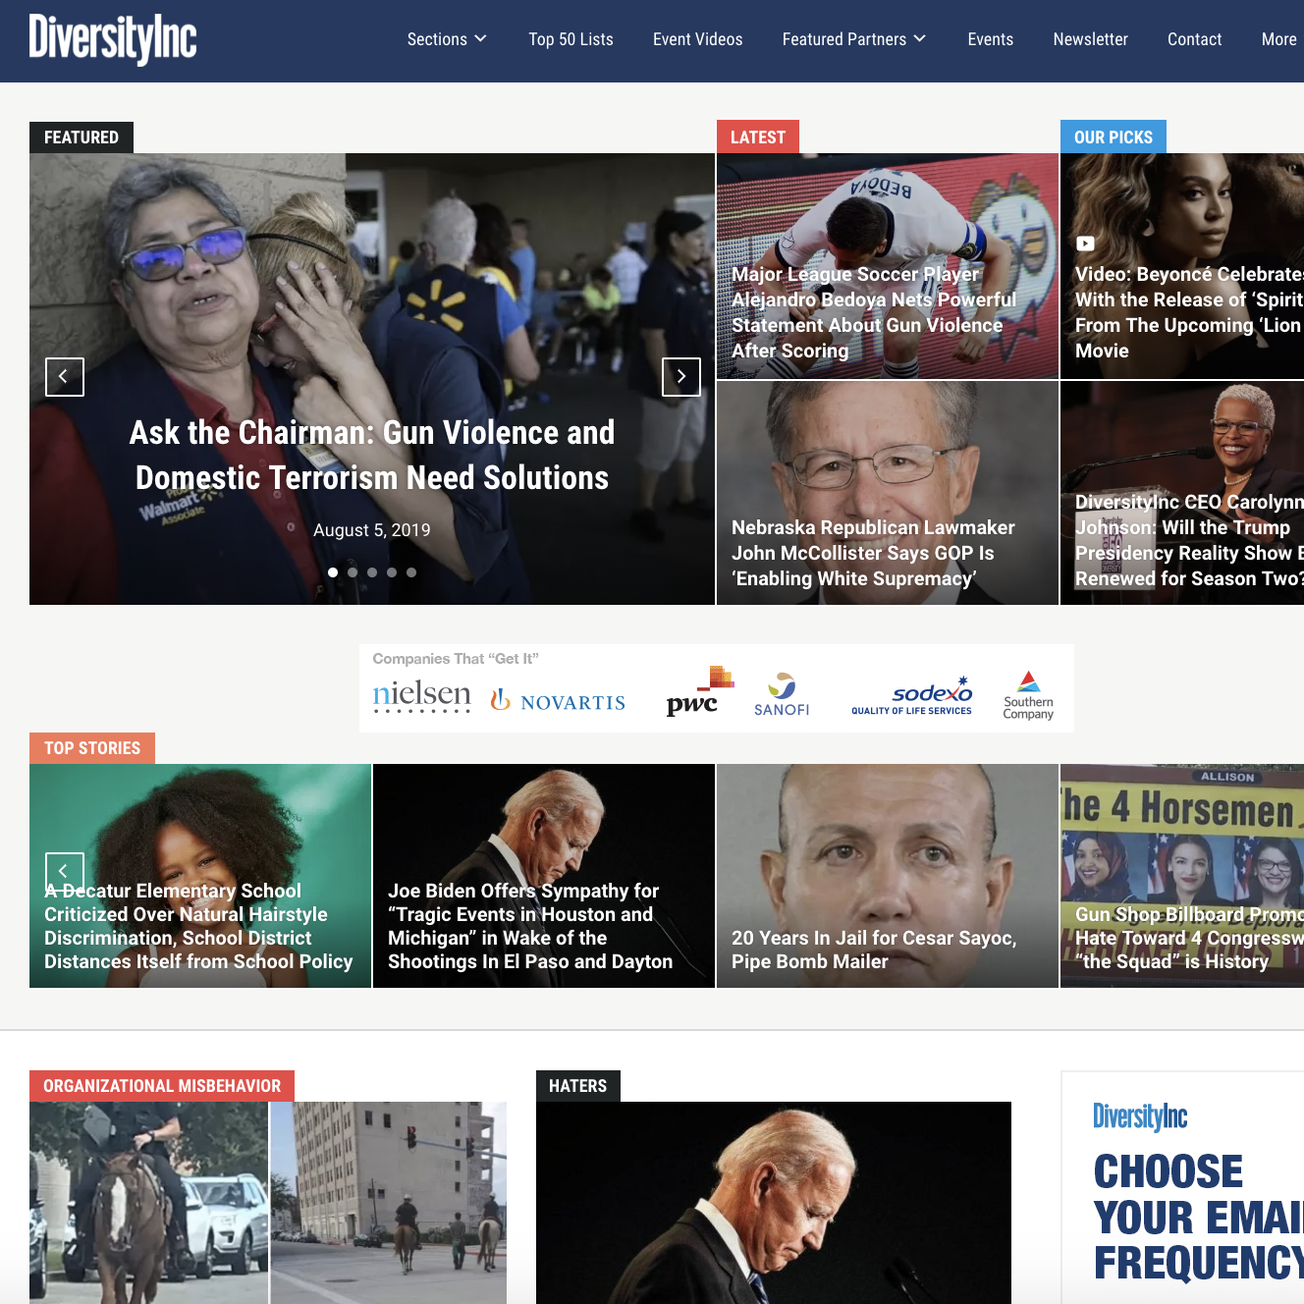
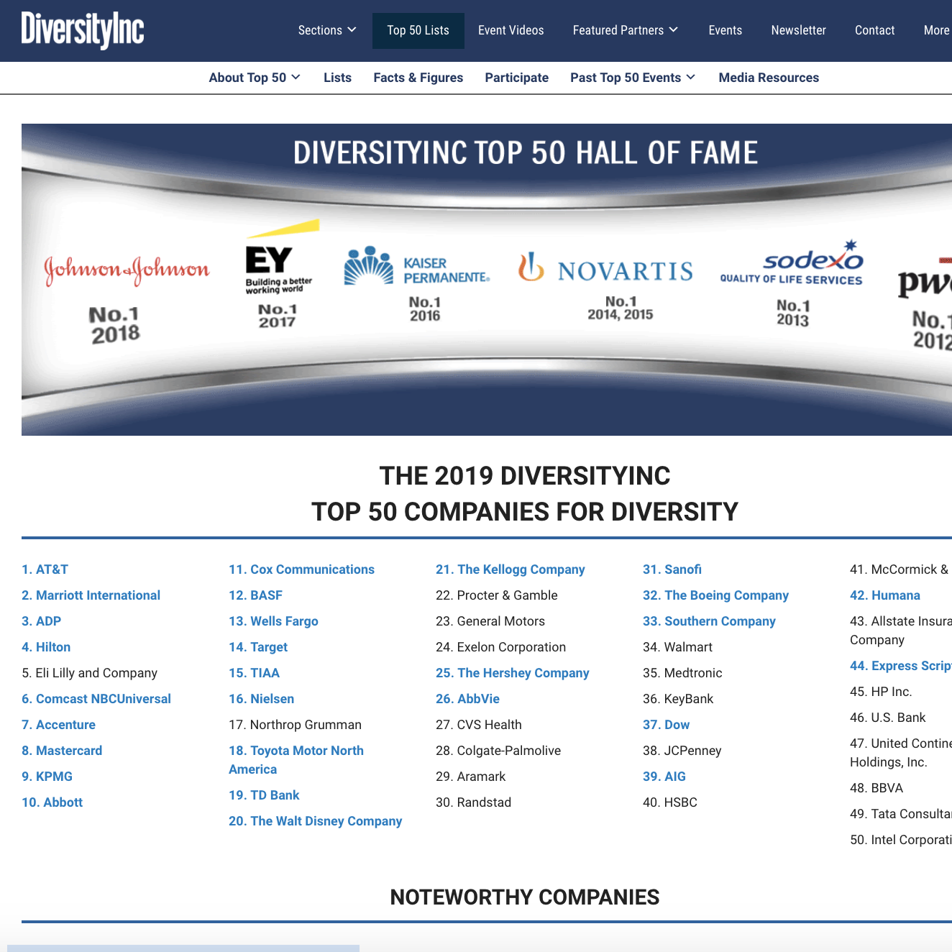
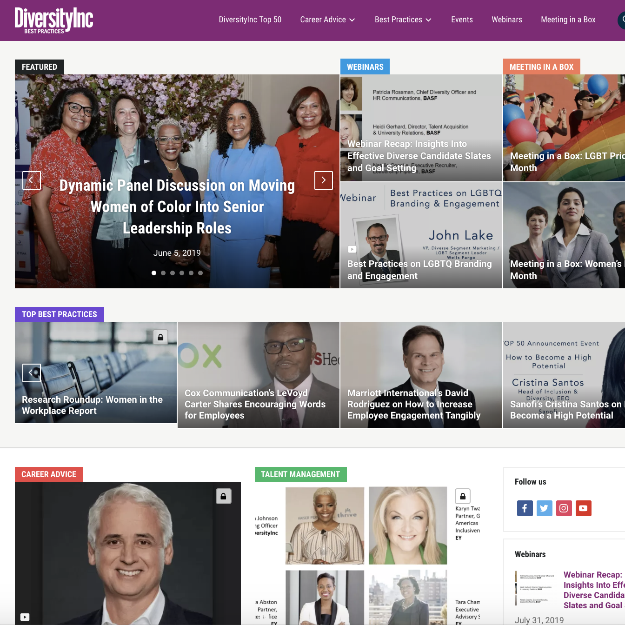
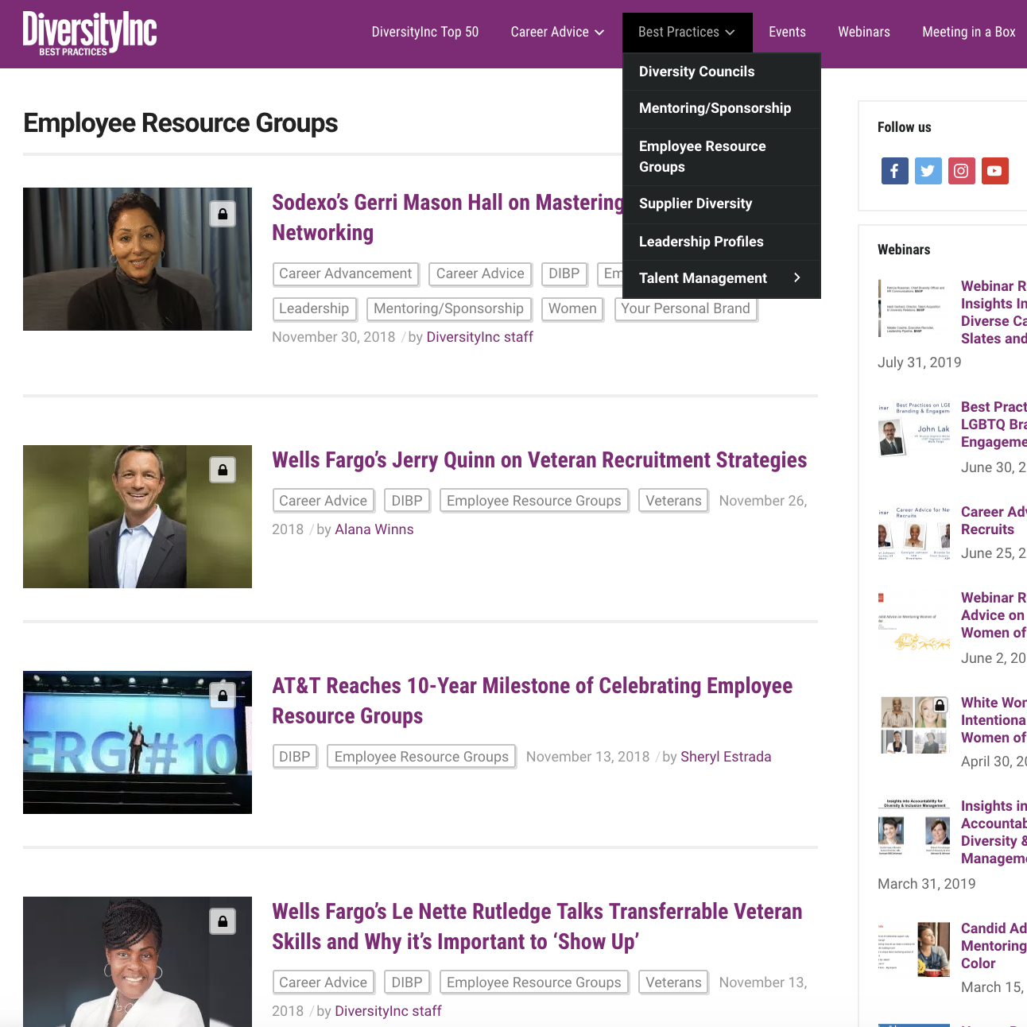
What We Do
Media
Benchmarking
Branding
Education
We work with diversity-focused teams to present the Top 50 Companies for Diversity Competition, deliver Benchmarking Advisory and provide Branding opportunities that spotlight our clients, provide positive press and support brand goals.
Partnering with close to 100 Benchmarking and Branding clients annually, we help companies develop actionable plans that produce results.

Slide 5
DiversityInc Top 50 Competition
In its 19th year, the DiversityInc Top 50 Competition remains the most prestigious diversity list. For 2019, we had more than 1,800 companies participate.
The DiversityInc Top 50 list is derived exclusively from corporate survey submissions. Companies are evaluated within the context of their own industries. Subsets of the same data submissions are used to determine our other specialty lists.
The DiversityInc Top 50 process is data and editorially driven and is not pay to play.
Participation is free. Every company that participates receives a free report card, assessing its performance against all competitors overall and in four key areas of diversity management.

Slide 6
DiversityInc Top 50 Competition
To be eligible to compete for a spot on any of DiversityInc’s Top Companies lists, participants must:
Have at least 1,000 U.S. employees
Enter data for your U.S. employee population and initiatives via Qualtrics, an online survey tool
Submit a notarized form signed by either the CEO, the chief human resources officer (CHRO) or a corporate officer (other than the chief diversity officer or person responsible for diversity & inclusion) affirming that all data submitted is accurate.
Complete NOD’s Disability Employment Tracker
Have at least one employee from the company attend the
Top 50 dinner

Slide 7
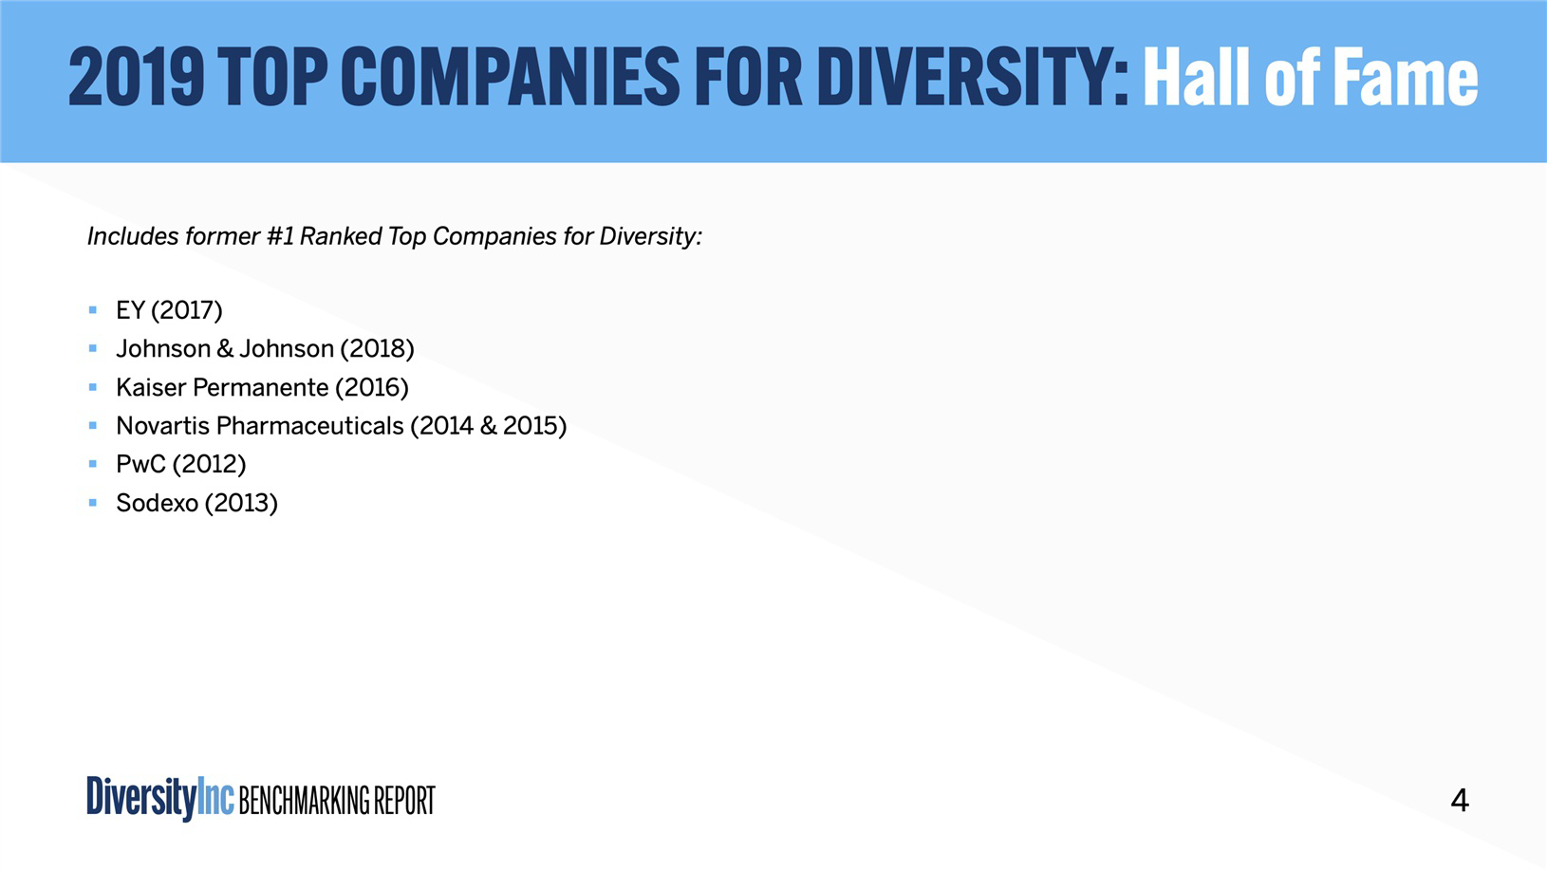
7

Slide 8
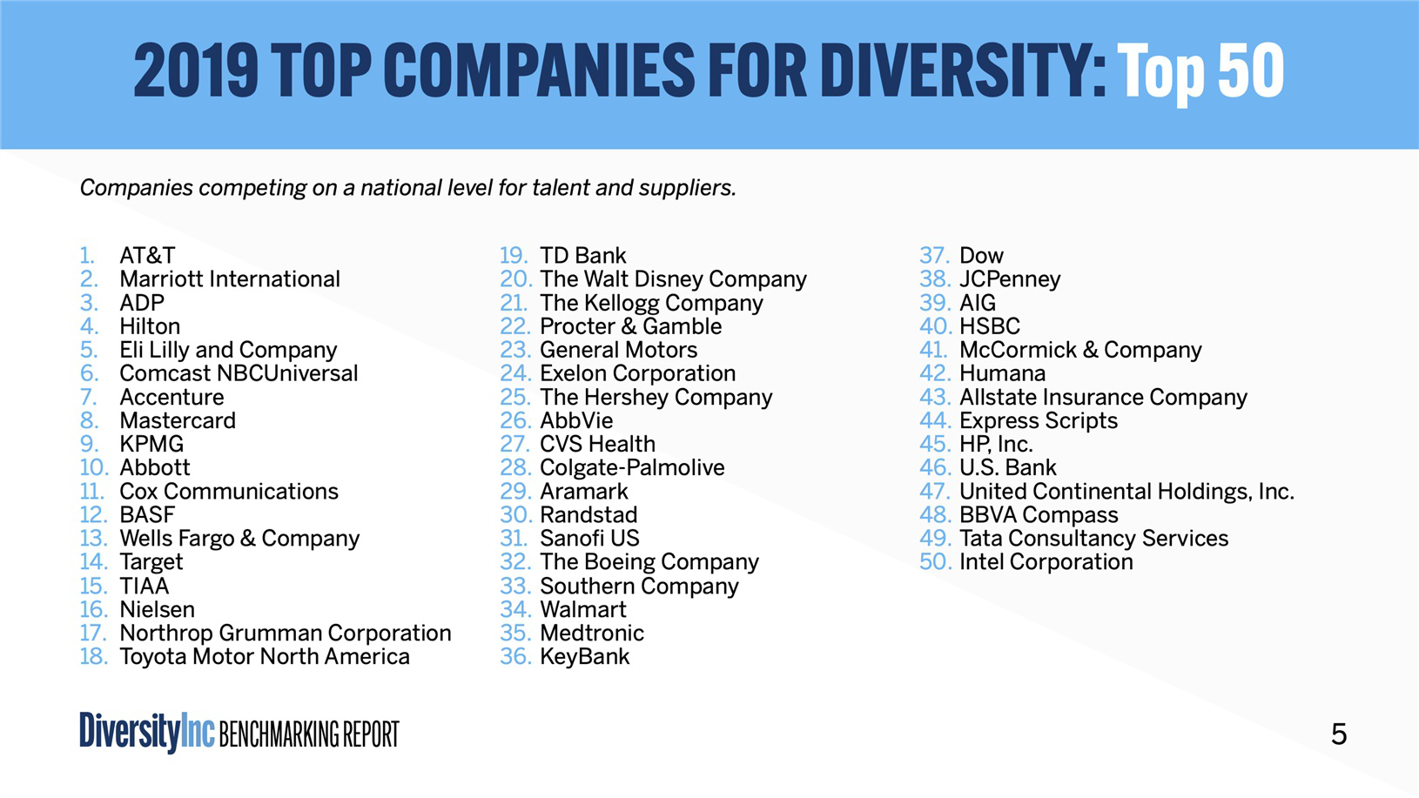
8

Slide 9
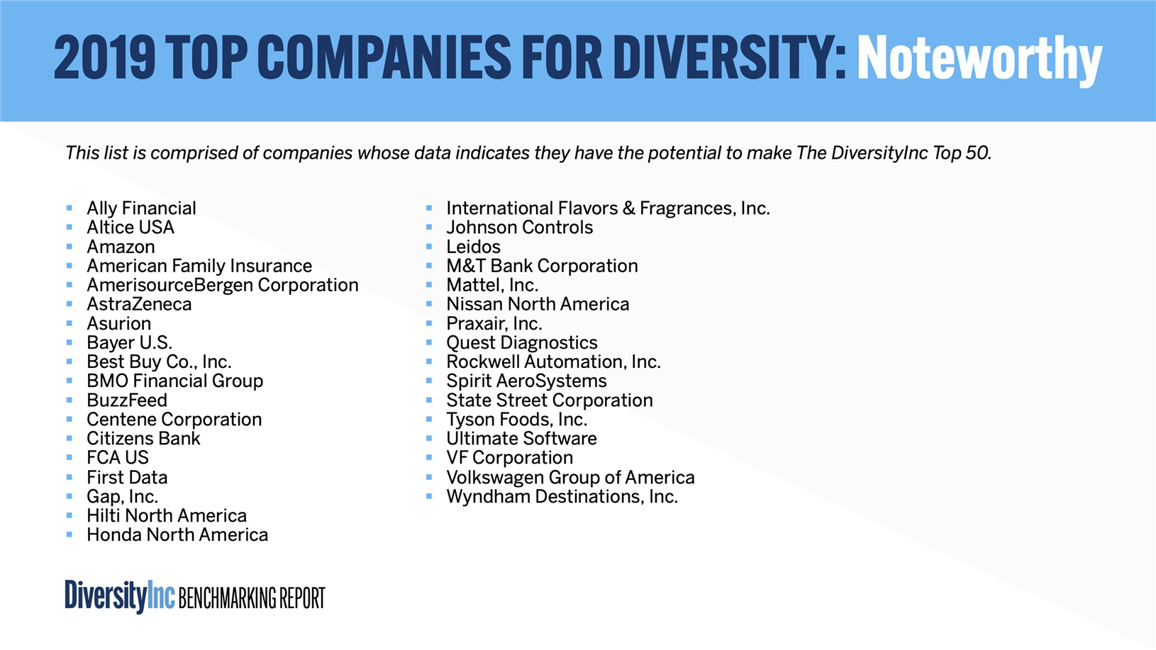
9

Slide 10
2019 Specialty Lists
Noteworthy Companies
Top Regional Companies
Top Hospitals and Health Systems
Top Utilities Companies
Top Companies for Talent Acquisition
Top Companies for Talent Acquisition for Women of Color*
Top Companies for Supplier Diversity
Top Companies for People with Disabilities
Top Companies for LGBT Employees
Top Companies for Employee Resource Groups
Top Companies for Mentoring
Top Companies for Sponsorship*
Top Companies for Diversity Councils
Top Companies for Diverse Leaders
Top Companies for Veterans
Top Companies for Executive Women
Top Companies for Philanthropy*
* New for 2019

Slide 11
What’s New for 2020?
Section of questions related to your company’s talent acquisition and management practices and outcomes
Questions regarding your company’s employee programs and practices related to Philanthropy and Corporate Social Responsibility
Reorganized existing questions related to Diversity & Inclusion Management function into a new section within the survey
Glossary of key terms and definitions as a reference when completing the survey
Hover text functionality for key terms in survey displaying the definition
Null value response option to questions in the survey

Slide 12
Understanding the 2020 Survey
Survey Categories
Human Capital Metrics
Leadership Accountability
Talent Programs
Workplace Practices
Supplier Diversity
Philanthropy

Slide 13
Understanding the 2020 Survey
Additional Information
Company EEO Report
Supplemental Data
Company Profile Information
National Organization on Disability (NOD) - Employment Tracker
Hospital/Health Care Systems

Slide 14
Understanding the 2020 Survey
Survey Category | Areas Addressed
Human Capital Metrics | Overall Representation, Management Representation, New Hires, Promotions, Turnover, Highest Paid 10%. Race/Ethnicity, Gender and Age Ranges data points.
Leadership Accountability | CEO/Sr. Management Commitment, Board of Directors, Diversity Council, Diversity & Inclusion Management
Talent Programs | Mentoring, Sponsorship, High Potentials, Employee Resource Groups
Workplace Practices | Talent Acquisition, Talent Management, Diversity Training, Onboarding, Veterans, People with Disabilities, LGBT, Employee Benefits
Supplier Diversity | Spend with Diverse Suppliers, Programs and Practices
Philanthropy | Volunteerism, Employee Matching, Philanthropic Giving & Involvement

Slide 15
Key Dates
15
TOP 50 COMPANIES SURVEY
SEPTEMBER 16, 2019
2020 Top 50 Survey opened
MARCH 3, 2020
Survey closes
MAY 5, 2020
Top 50 Companies for Diversity announced

Slide 16
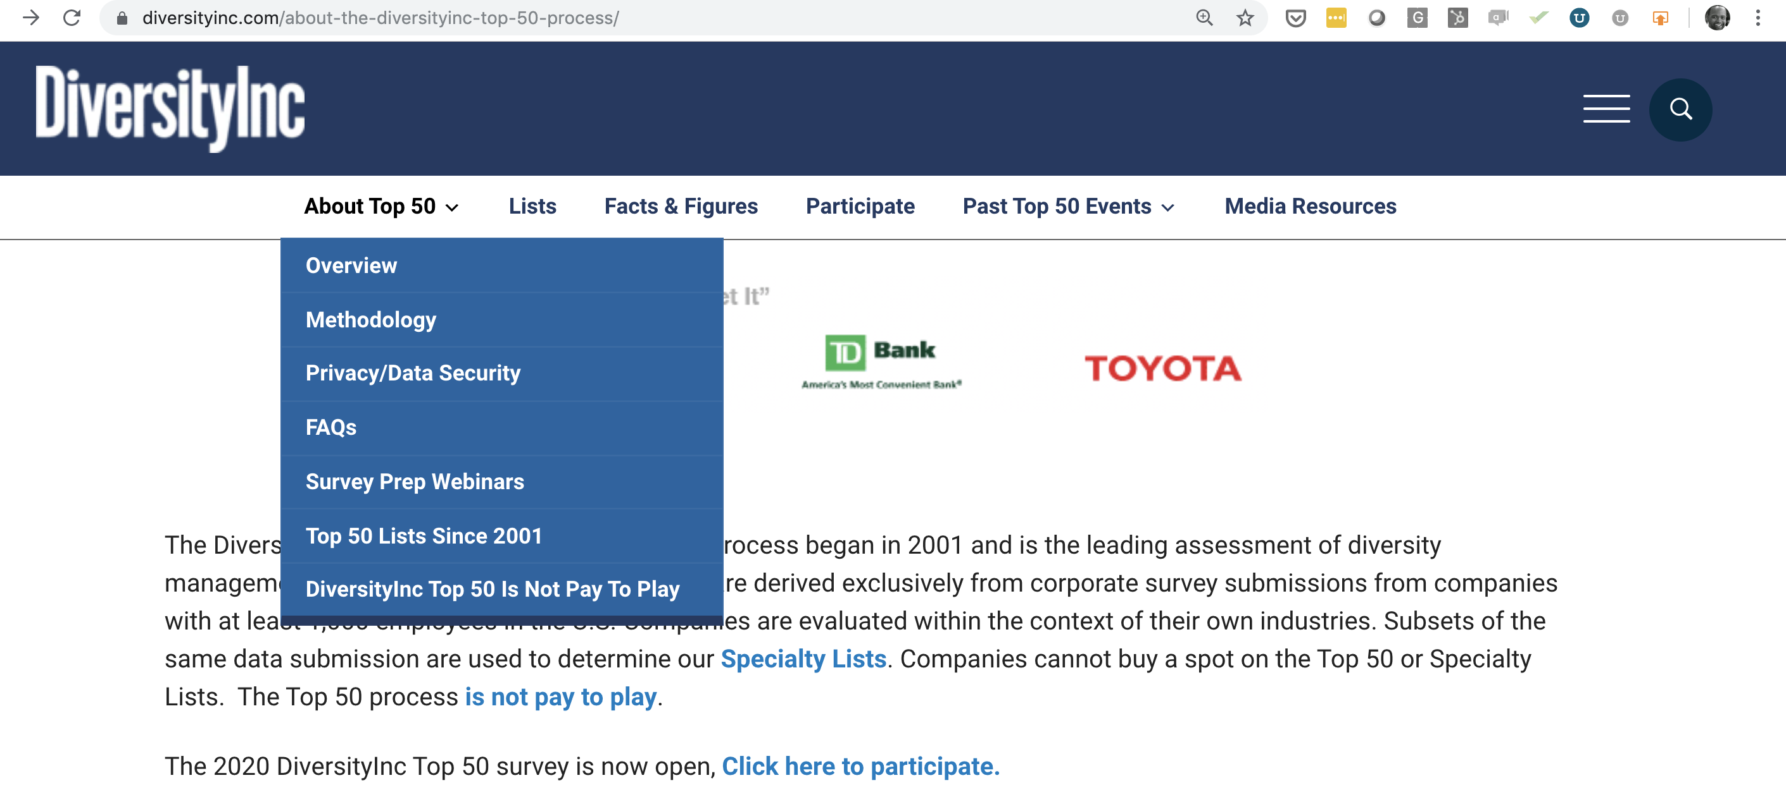
Completing The Survey: Tips & Best Practices
Track your survey completion progress

Slide 17
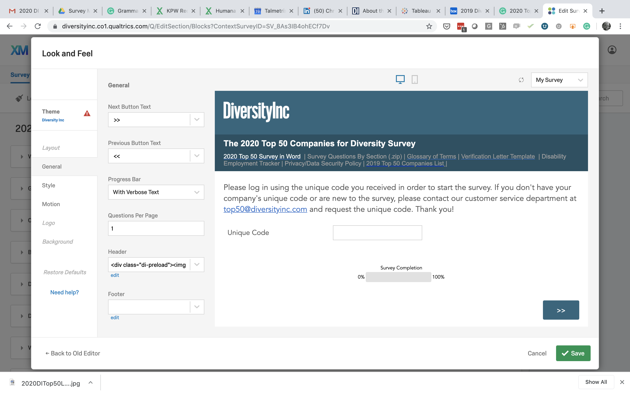
Completing The Survey: Tips & Best Practices
Download a word copy of the complete survey and access a zip file of survey questions by section, verification letter template, NOD’s Disability Employment Tracker, data security policy, previous Top 50 lists and a glossary of terms
Track your survey completion progress
Enter unique code assigned to your company

Slide 18
Completing The Survey: Tips & Best Practices
There are several events and milestones companies tell us happen internally:
Timeline | Key Tasks
September - November | Kickoff emails or meetings to let departments know what is needed, remember to include your legal department.
December - January | Data requests – sent to HR, supplier diversity, philanthropy, etc.
Typically by end of January | Data collection completion
1st week of February | Finalize survey responses
2nd week of February | Legal/Compliance Department Review
3rd week of February | CEO, CHRO or other corporate officer signs off on submission
By March 3, 2020 | Submit completed survey

Slide 19
Sample Report Card

Slide 20
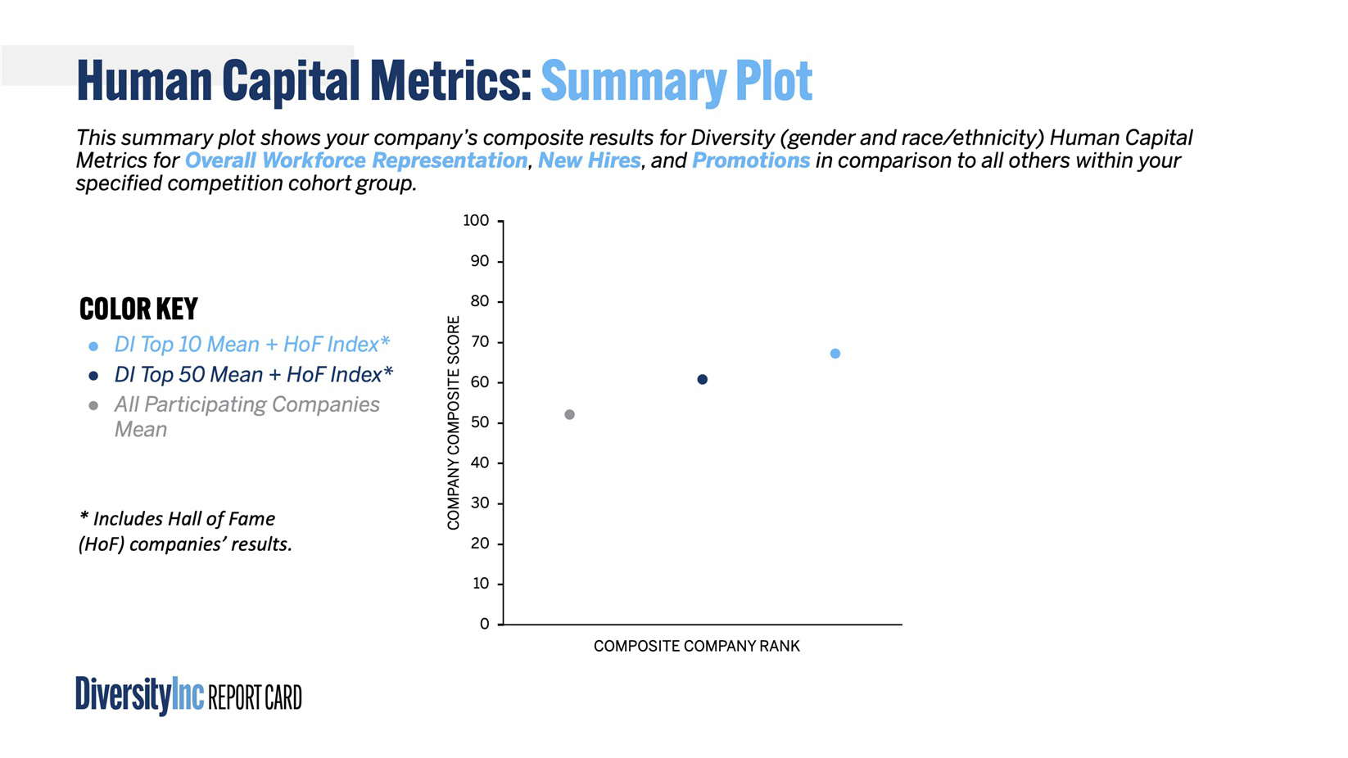
20
Descriptor identifies what survey items are included in the scoring and analysis
Company A
The dots represent the category mean composite score for the Top 10*, Top 50* and all participating companies
Composite scores range from 0 (worst) to 100 (best)
Composite company rank represents a company’s rank in the Top 50. The further right, the higher the rank.

Slide 21
Human Capital Metrics: Heat Map
Heat maps show the percentages of a given group in the area
(e.g. 2.17% Latino Women in Overall Workforce in 2019 survey).
21
WORKFORCE OVERALL
DI Top 10 Index*
 |  | 2018
Women Representation Overall | Total | 36.09%
 | Asian | 2.10%
 | Black | 3.77%
 | Latino | 2.15%
 | American Indian | 0.21%
 | Other | 0.33%
 | Two or More Races | 0.20%
 | White | 27.34%
Men Representation Overall | Total | 63.91%
 | Asian | 3.02%
 | Black | 5.67%
 | Latino | 3.91%
 | American Indian | 0.38%
 | Other | 0.99%
 | Two or More Races | 0.47%
 | White | 49.47%
Women New Hires Overall | Total | 32.08%
 | Asian | 2.40%
 | Black | 4.26%
 | Latino | 2.55%
 | American Indian | 0.05%
 | Other | 0.59%
 | Two or More Races | 1.08%
 | White | 21.16%
Men New Hires Overall | Total | 67.92%
 | Asian | 3.62%
 | Black | 7.25%
 | Latino | 5.09%
 | American Indian | 0.59%
 | Other | 1.57%
 | Two or More Races | 1.67%
 | White | 48.14%
2019
36.13%
2.15%
3.74%
2.17%
0.19%
0.80%
0.22%
26.86%
63.87%
3.04%
5.77%
3.94%
0.39%
1.68%
0.51%
48.54%
31.48%
2.97%
3.44%
3.36%
0.08%
0.47%
0.63%
20.55%
68.52%
3.67%
8.59%
4.53%
0.31%
1.41%
1.88%
48.13%
Percentages are compared with the Top 10 + HoF mean.
Benchmarking clients receive a report with Top 10 + HoF values.
Cells are colored (“traffic light” labeled) according to the normal approximation of the sampling distribution of the Index mean.
Notes:
2018 Heat Map is based on the 2018 DI Index.

Slide 22
Benchmarking customers can request additional cuts of the data.
22
Benchmarking clients receive a detailed report that includes the frequency rate in which the Top 10+ HoF companies have practices in place.

Slide 23
Frequently Asked Questions
Q: How many people can enter data in the online survey tool on behalf of my company?
A: Anyone you designate internally may complete the survey, but we recommend one person, usually someone familiar with diversity and inclusion management, be the primary person filling it out. You will be required to enter a code unique to your company; the link provided will take you directly to the survey, and you will be prompted to enter the code there. The link is secure and can only be accessed by you and others at your company with whom you share it. Please be sure to only share the link with those responsible for helping you fill it out.
Q: Do I need any special software to access the survey?
A: No. We use Qualtrics, an online survey software, to capture your company’s submitted data. We cannot enter data for you. A Word document is available for internal data-gathering purposes only.

Slide 24
Frequently Asked Questions
Q: What is DiversityInc’s policy on data handling and privacy?
A: We do not divulge specific demographic data of any company, and we guarantee its confidentiality. If a company makes the DiversityInc Top 50 list or one of our Specialty Lists, we only discuss the shared best practices it uses that helped it make the list. We never release a company’s human capital metrics, supplier diversity or philanthropy spend data. There is no negativity associated with participation. If a company does not make the list or one of our other lists, its name is never revealed.
Q: Can we include employees outside of the United States?
A: No. You may only enter data about your programs and employee representation in the United States (including U.S. territories).
Q: Can we request copies of our submissions from previous years?
A: Once the survey submission process closes, DiversityInc will only provide one PDF of a complete submission. Additionally, company report cards are no longer distributed once the following year’s Top 50 survey process is open.

Slide 25
Frequently Asked Questions
Q: Do we have to provide answers to all the questions in the survey in order to compete?
A: There are some questions where we have required a response to prevent calculating null values into the ranking algorithm. The system will notify you of the questions that require a response. In these cases, we have either provided you an option to select no response or enter zero.
Q: Is there a character limit for the open-ended questions to provide responses?
A: No. There is no character limit for those questions in which you have the opportunity to explain further.
Q: Is there a glossary of terms that provides scope and/or definition for unique terms within the survey?
A: Yes. There is a list of terms used in the survey and the associated definition and/or scope as it relates to the Top 50 survey.

Slide 26
Frequently Asked Questions
Q: Who do we contact if we have questions and/or need technical support accessing or completing the survey?
A: Please send an email to top50@diversityinc.com with your questions and/or technical issues.
Q: How do you confirm the information from companies that apply for your top company award?
A: We look for statistical anomalies, outliers and illogical answers. We also spot-check survey questions randomly. We may notify companies if there are anomalies in their submission prior to the survey closing. We also require companies to have their CEO or another company officer (does not include the chief diversity officer or person responsible for diversity & inclusion) sign a letter confirming, that to the best of their knowledge, the data submitted is correct. The letter must be notarized.

Slide 27


27
Q&A
Please use the text chat box in the control panel to enter in your questions.

Slide 28
DiversityInc Best Practices (DIBP)
Subscribe to DIBP to get access to relevant information and resources to provide your employees, managers, ERG leaders and HR/ Diversity professionals with:
Features | Benefits
Diversity Management Content | Articles, videos, case studies and webinars that show how top companies for diversity are effectively using best practices to get talent results.
Career Advice Series | Webinars and content series to provide information and/or tools for your employees and managers regarding career development and management for diverse employee populations.
Research & Insights | Leverage relevant and timely research to inform your diversity and inclusion initiatives.
Take the interactive tour: www.diversityincbestpractices.com/st/DIBP_Sampling

Slide 29
29
Upcoming Webinars
October 8 | Career Advice for Women of Color
Career advice specifically for women of color, such as finding mentors, navigating the corporate landscape and work/life integration, to name a few.
October 22 | Successfully Recruiting Persons with Diverse Abilities
Best-in-class companies share insights on how they effectively recruit persons with diverse abilities.

Slide 30
Upcoming DiversityInc Events
30
SIGNATURE EVENTS
OCTOBER 2, 2019
Women of Color & Their Allies Conference I Atlanta Downtown Hilton
NOVEMBER 12, 2019
Employee Resource Group Festival I Newark Airport Marriott
MAY 5, 2020
Top 50 Companies Learning Sessions and Event I Cipriani New York

Slide 31
31
Thank You for Attending
You will receive an email from us containing a link to download this presentation.
If you have questions/comments, please email us at customerservice@diversityinc.com.
Visit DiversityIncBestPractices.com to view past webinars and career advice, as well as relevant, up-to-date content on diversity and inclusion management.

